Slide 1

Practice of Deep Learning Day 2, Part 4/4
Matthieu De Mari

Slide 2
Day 2 Lab submission
As part of your assessment, please submit your report (it should contain answers to all questions, including the code snippets requested in some of the questions).
Note: No need to submit the notebooks along with your report, as long as the requested code snippets are shown in your report.
Submit via email at matthieu_demari@sutd.edu.sg
Deadline: April 1st 2026, 11.59pm

Slide 3

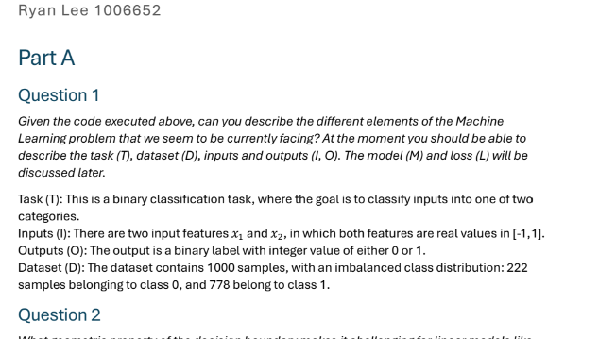
A typical report, we have received in the past

